Slide 1
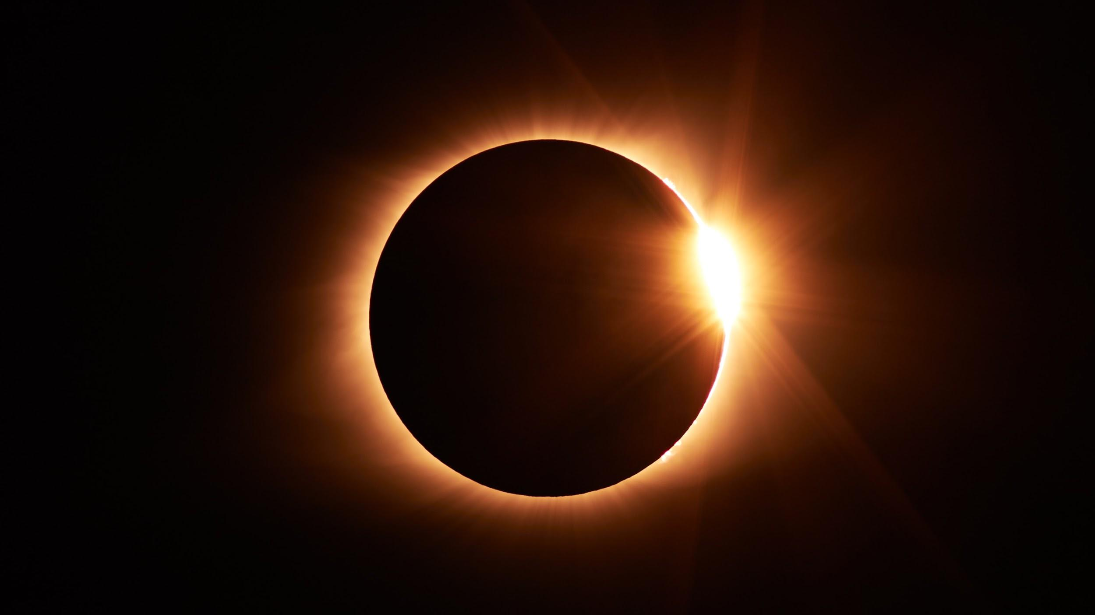
ECLIPSES
We will model the movements of Earth, the sun and the moon during eclipses.
Notes:
Insert cover image and use transparency settings to fade image.

Slide 2
Do not delete this slide.
This slide is designed so that you can copy the prompt box you need and insert it into your slides.
This slide is hidden and will not be included when presenting your lesson.
TRACK WITH ME
VOCABULARY
1 -
HINT
Students, remember….
CHECK FOR UNDERSTANDING
READ WITH ME
TEACHER CUE
MAKE THE CONNECTION
Students, you already know….
EXTENSION
GESTURE WITH ME

Slide 3
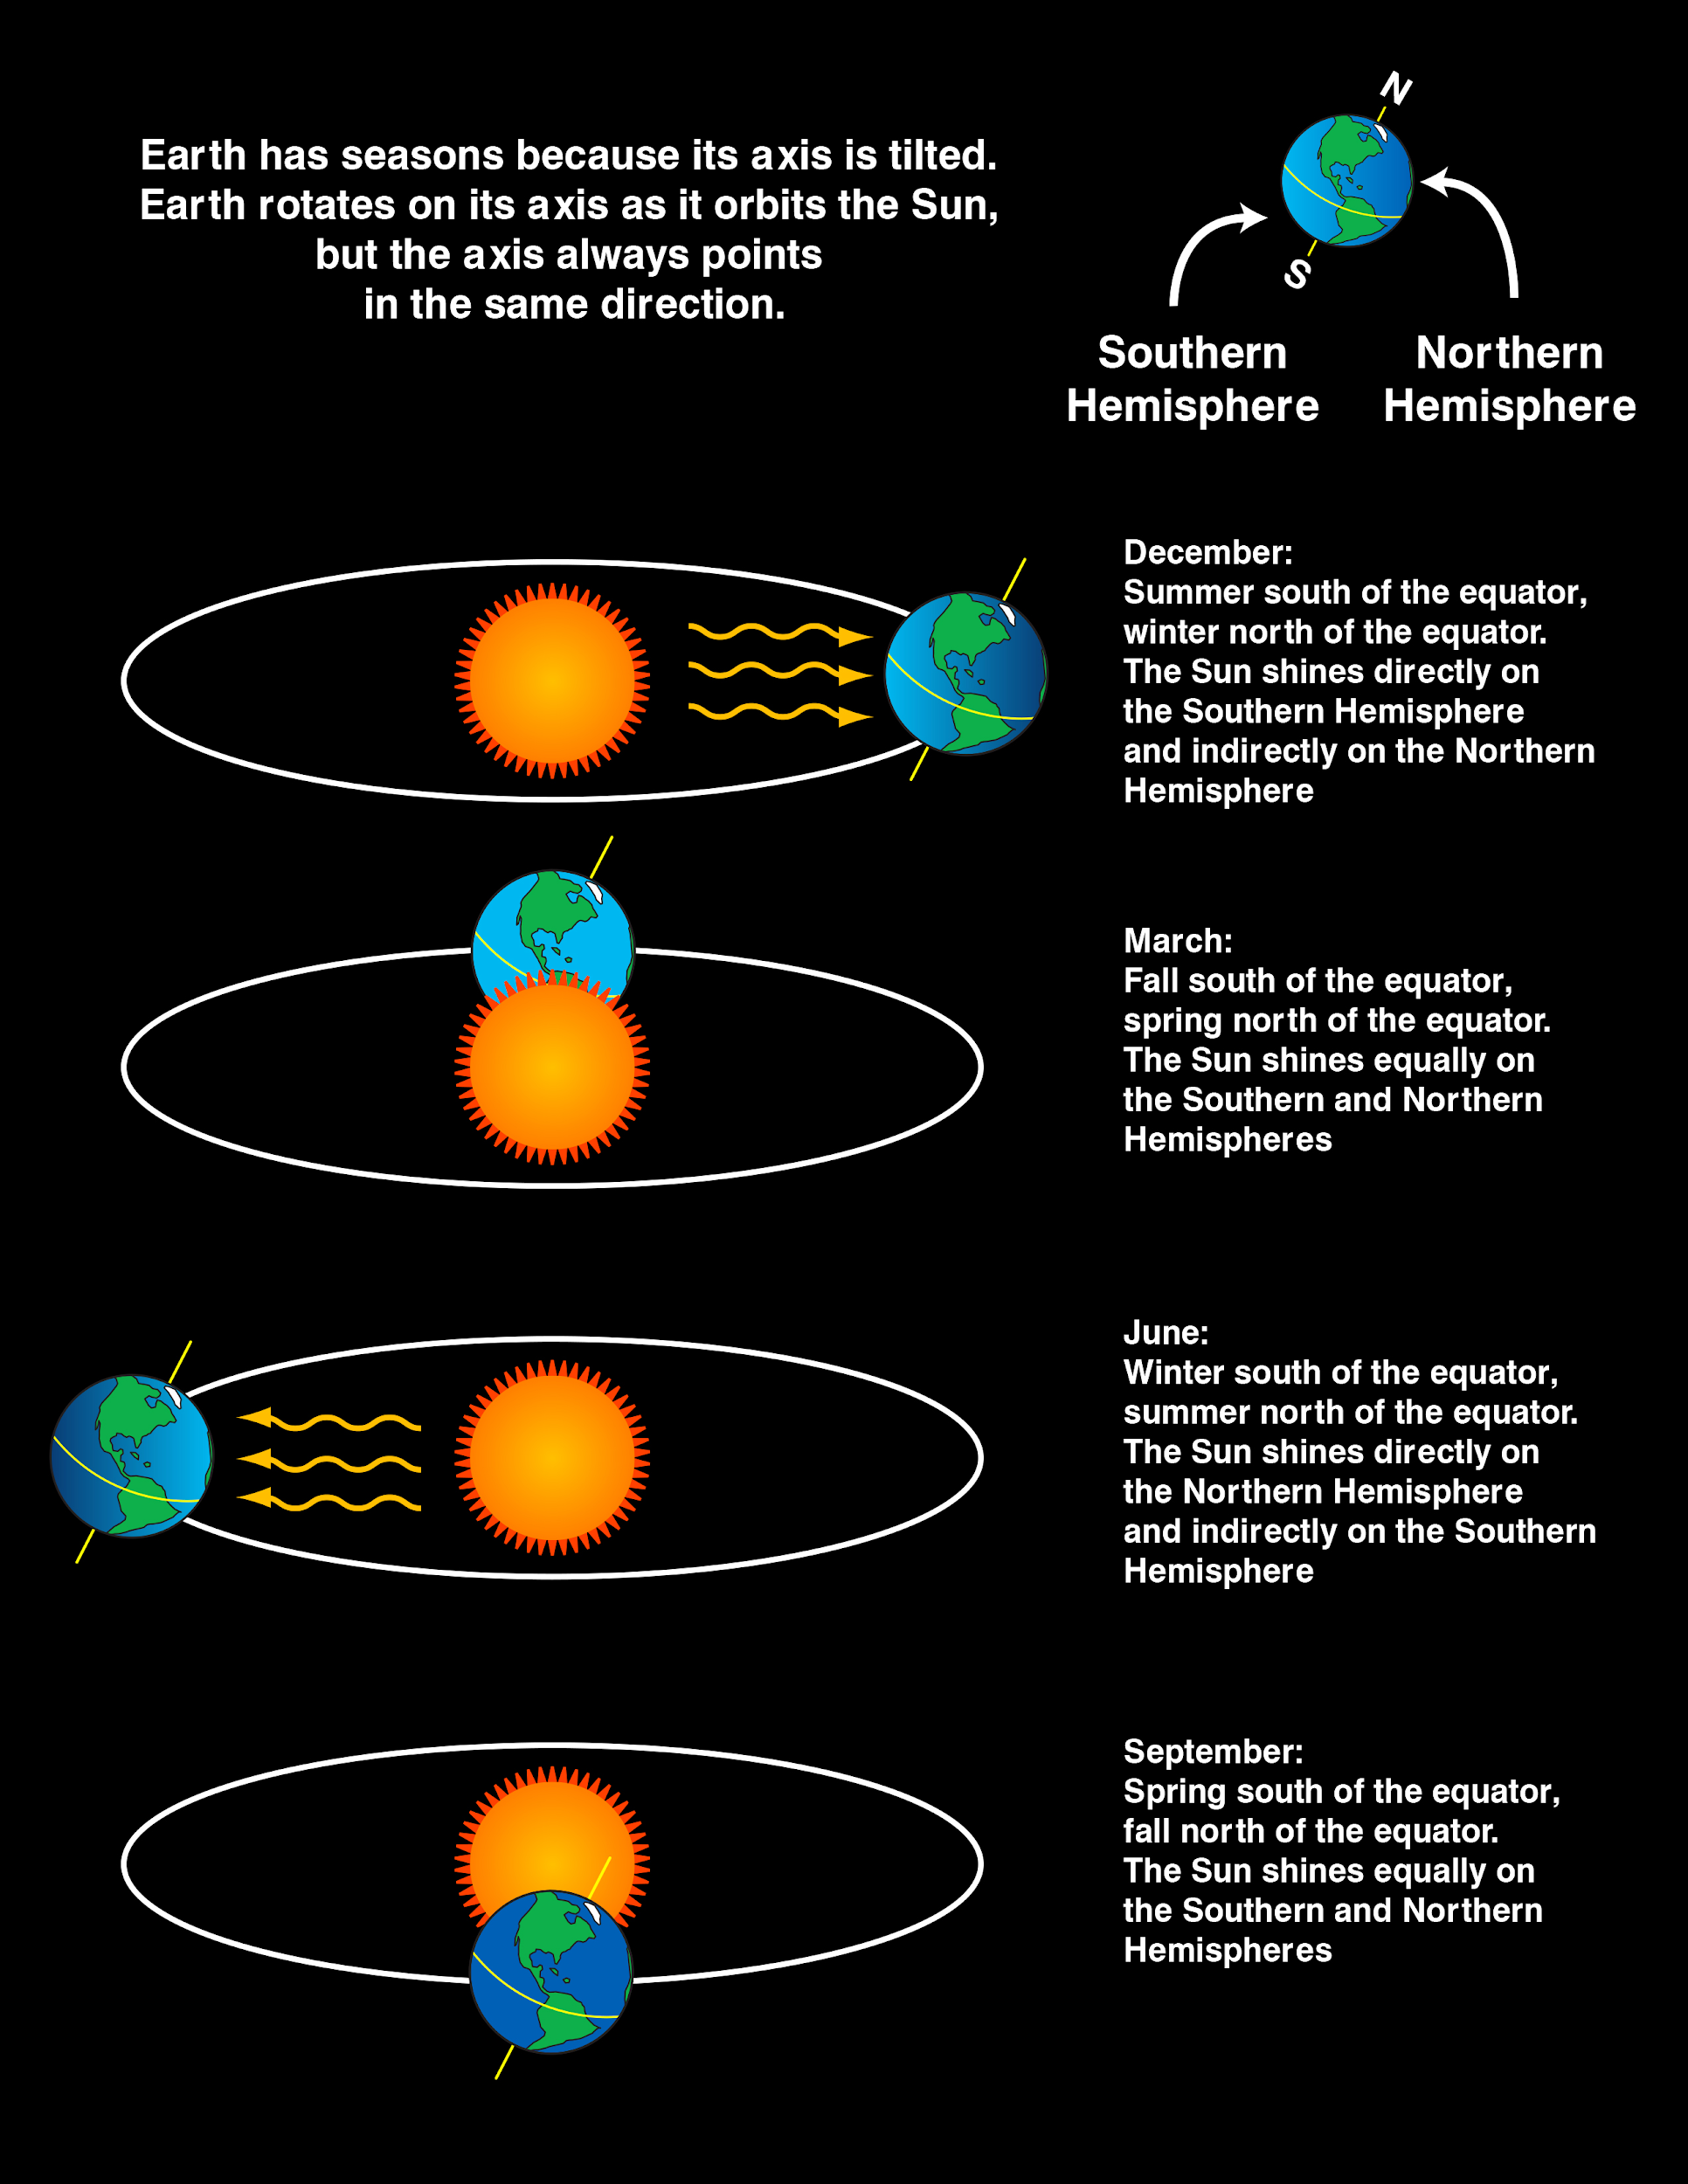
Is this diagram is the Southern hemisphere showing
Summer
Autumn
Winter
Spring
Explain how you know this in your white boards.
Northern Hemisphere
Southern Hemisphere

Slide 4
Repeat the opposite word/phrase.
ROTATION
SPINS AROUND AN AXIS

Slide 5
Repeat the opposite word/phrase.
REVOLUTION
1 FULL ORBIT

Slide 6
Repeat the opposite word/phrase.
BIRAK
SUMMER

Slide 7
Repeat the opposite word/phrase.
MAKURU
WINTER

Slide 8
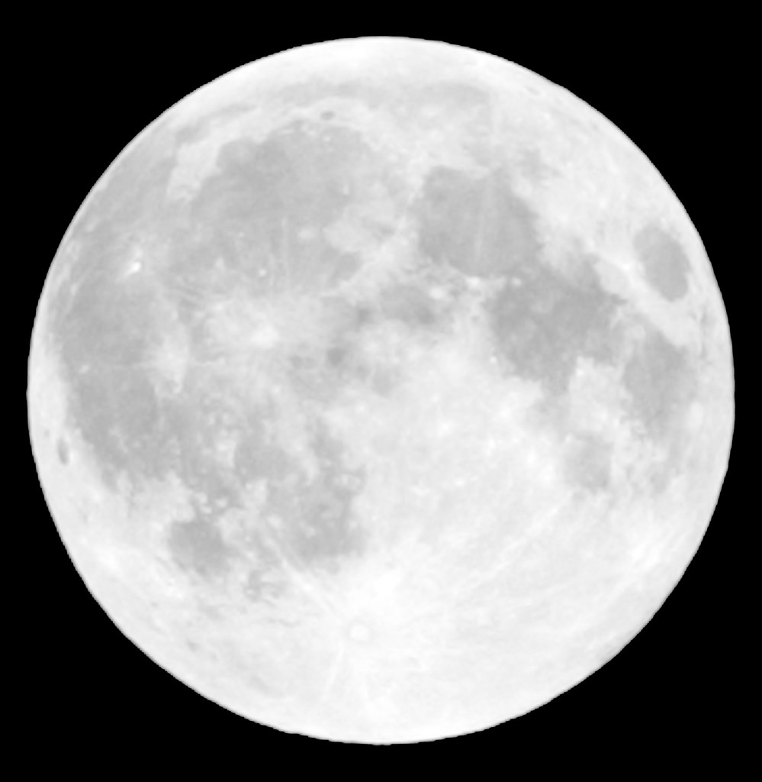
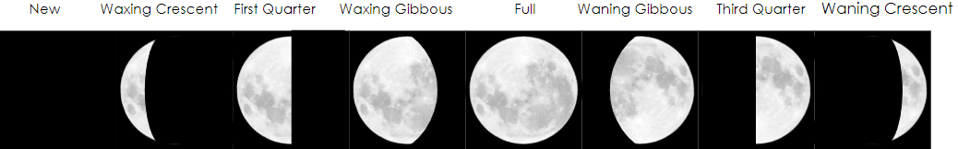
Which phase of the moon is this?
2. Which phase of the moon is this?

Slide 9
True or False:
Earth takes 365 days to rotate on its own axis:__________
Mercury has the shortest revolution period ________
The Moon takes 27 days to complete 1 orbit ______
Jupiter spins on its axis _________

Slide 10
We will model the movements of Earth, the sun and the moon during eclipses.
TRACK WITH ME
READ WITH ME
We will define solar eclipse.
We will define lunar eclipse.
We will compare partial and total eclipses.
DECLARE THE OBJECTIVE
Read the learning objective to your partner.
Notes:
Learning Objectives contain concepts (nouns, big ideas), skills (verbs, measurable behaviours) and sometimes context (restricting or targeting conditions).
●Example: Students will be able to describe the concept of density and apply it to floating and sinking.
●
Success criteria are specific measurable outcomes that if met mean that the student has met the learning objective.
Examples:
•Students will be able to compare densities of substances using mass and volume.
•Students will be able to identify whether a solid or liquid will float or sink in a liquid based on their densities.

Slide 11
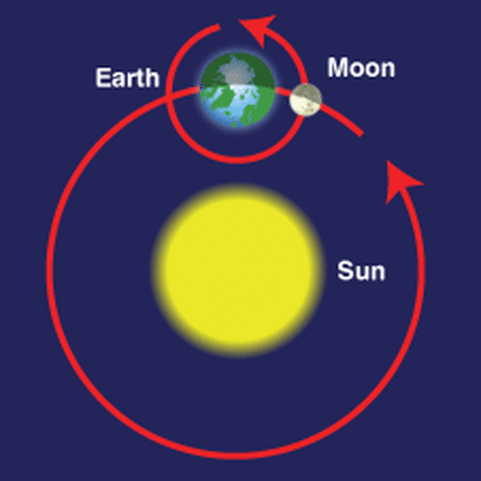
We will model the movements of Earth, the sun and the moon during eclipses.
The Moon orbits the Earth and the Earth orbits the Sun.
Using the diagram, what do you think would happen if the moon was between the Earth and the sun?
MAKE THE CONNECTION
Students, you already know…. The Moon reflects the light of the sun but sometimes it has shadows on it too.
Notes:
Image from https://www.theatlantic.com/science/archive/2017/08/annie-dillards-total-eclipse/536148/

Slide 12
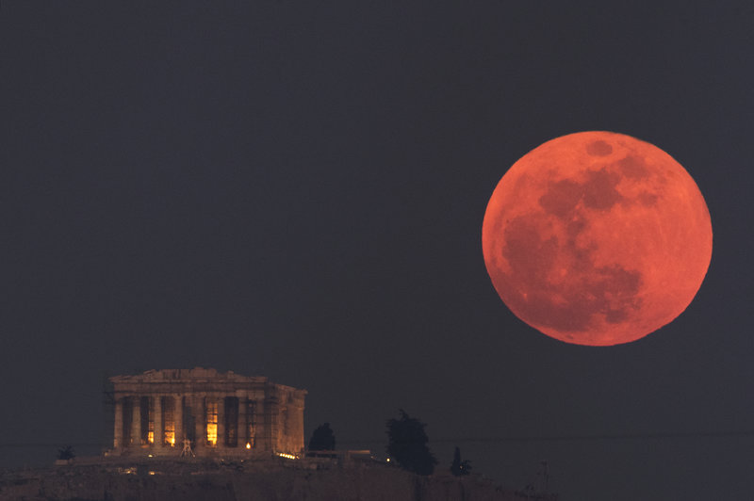
We will model the movements of Earth, the sun and the moon during eclipses.
An eclipse occurs when one celestial₁ object passes in front of another making a shadow on the Moon or blocking the light of the sun.
CHECK FOR UNDERSTANDING
Is this diagram below a solar or lunar eclipse? Explain your answer
Type of eclipse | Order of celestial objects | When does it occur | What we look at
Solar eclipse | Sun-moon- earth S-M-E | Day time | The Sun
Lunar eclipse | Sun-earth-moon S-E-M | Night time | The Moon
VOCABULARY
1 - object in space

Slide 13
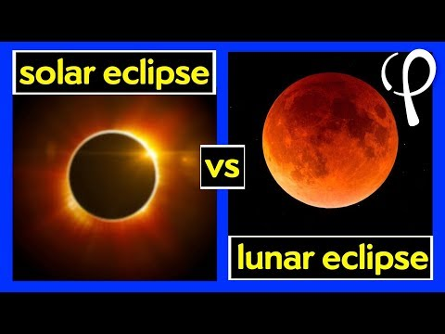
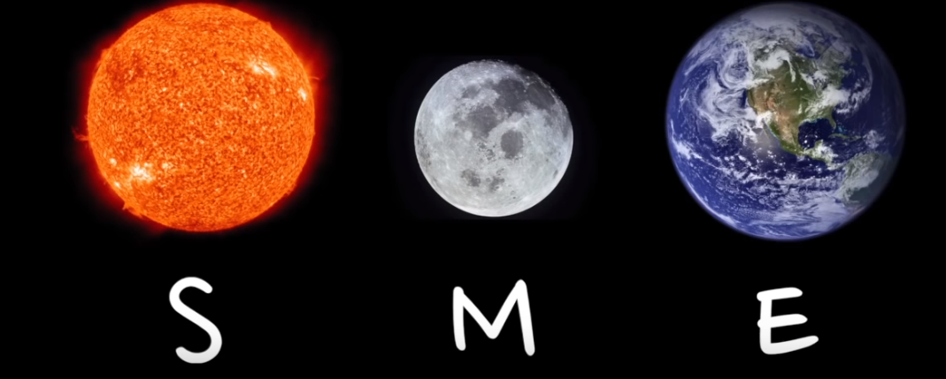
We will model the movements of Earth, the sun and the moon during eclipses.
CHECK FOR UNDERSTANDING
Which type of eclipse has the order SME? A solar eclipse A lunar eclipse Explain your answer

Slide 14
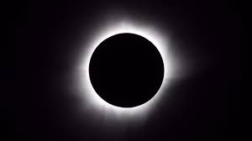
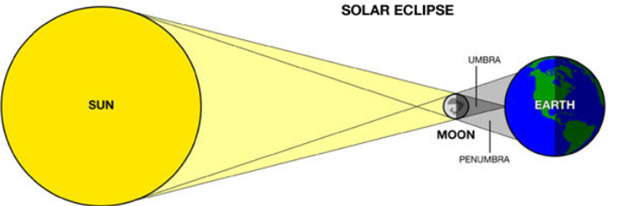
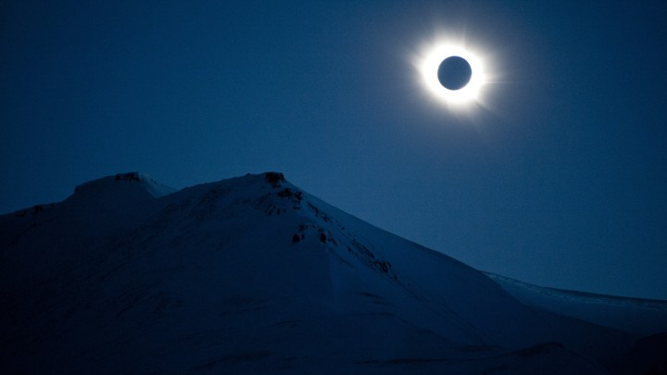
We will model the movements of Earth, the sun and the moon during eclipses.
A total solar eclipse occurs when the moon moves in front of the sun. The moon blocks the sun and creates a shadow on Earth.
Umbra is the shadow on the Earth.
A model of a Solar eclipse:
CHECK FOR UNDERSTANDING
Why will the area marked with an X on the globe not see the solar eclipse?
View from Earth in the umbra
X
x

Slide 15
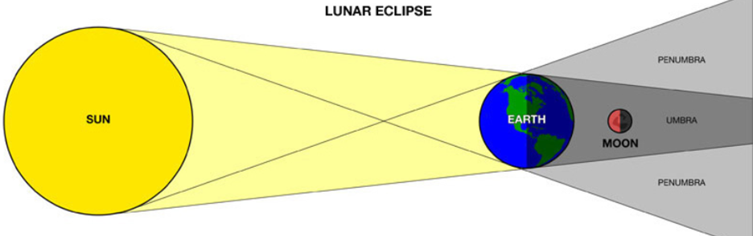
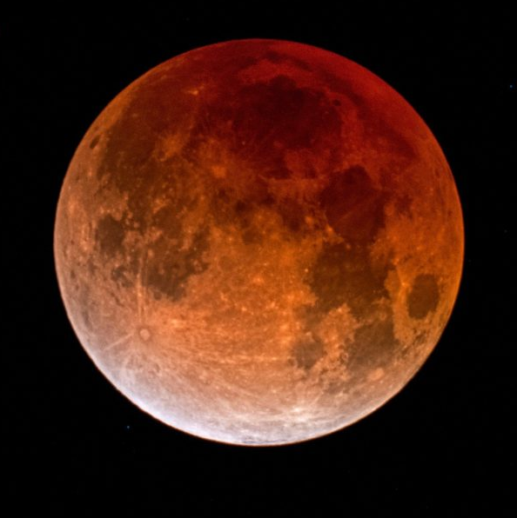
We will model the movements of Earth, the sun and the moon during eclipses.
A total lunar eclipse occurs when the Earth moves between the moon and sun. The Earth blocks the sun and creates a large shadow on the moon.
Umbra is the shadow on the moon.
A model of a lunar eclipse:
CHECK FOR UNDERSTANDING
Why is the umbra (shadow) bigger in a lunar eclipse?
The moon viewed from Earth

Slide 16
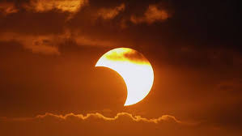
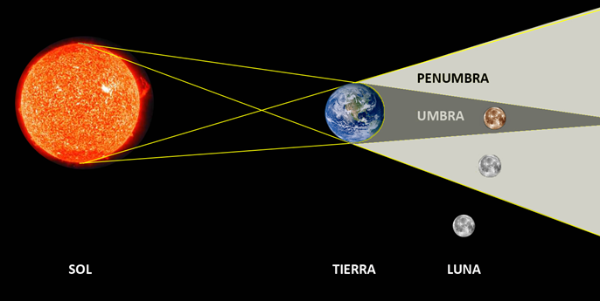
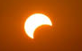
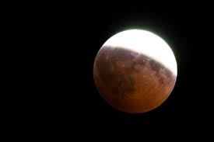
We will model the movements of Earth, the sun and the moon during eclipses.
A partial eclipse occurs in 2 ways marked by an X
In a solar eclipse when you’re located in the penumbra₁
In a lunar eclipse when the moon is in the penumbra
CHECK FOR UNDERSTANDING
Is this diagram showing a partial or total lunar eclipse with the circled moon?
X
X
X
VOCABULARY
1 - part shadow
X

Slide 17
We will model the movements of Earth, the sun and the moon during eclipses.
HINT
Students, remember…. An eclipse means it makes a shadow or blocks the sun.
Fill in the table to identify the solar and lunar eclipse.
Identify them as total or partial eclipses
Name of eclipse | Order | When it occurs | What we look at | Letter | Total or partial eclipse
Solar eclipse | S M E | Day time | Sun
Lunar eclipse | S E M | Night time | Moon
B
A
X

Slide 18
We will model the movements of Earth, the sun and the moon during eclipses.
HINT
Students, remember…. S M E = solar eclipse. The moon moves in font of the sun, blocking the light making a shadow on the Earth. S E M = lunar eclipse. The Earth moves between the moon and sun. The earth blocks the sun and makes a shadow on the moon.
Fill in the blanks 1-4 to define a solar and lunar eclipse using the diagrams below.
A total solar eclipse occurs when the 1_________ moves in front of the sun.
The Moon blocks the sun and creates a shadow on 2________.
A total lunar eclipse occurs when the 3 ________ moves between the moon and sun.
The Earth blocks the sun and creates a large shadow on the 4________.

Slide 19
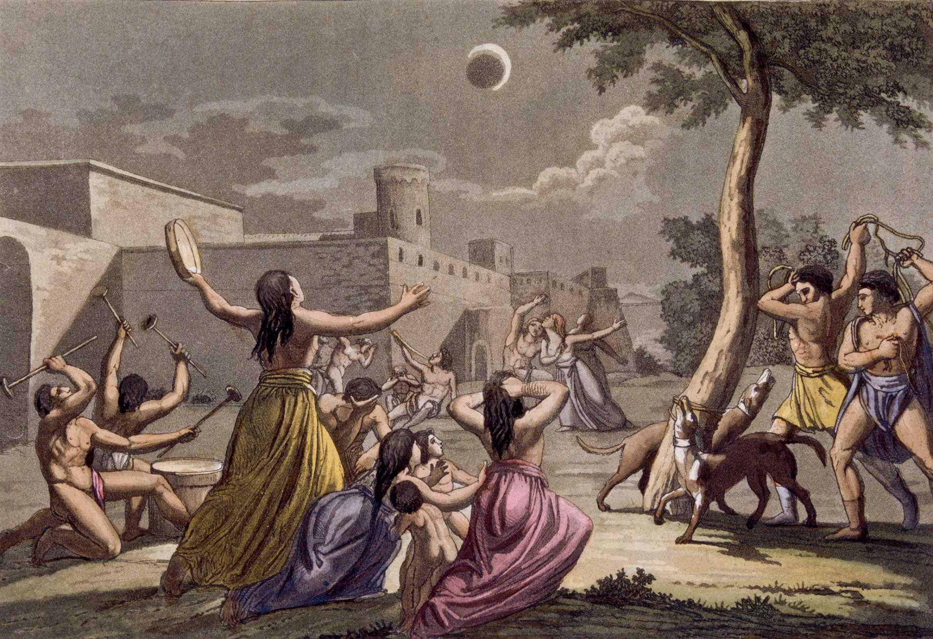
We will model the movements of Earth, the sun and the moon during eclipses.
Ancient civilisations did not understand eclipses and associated them with disasters, sacrifices to the gods and magic.
Current knowledge helps us understand the true meaning of these events from a scientific point of view.
The Inca feared that a lunar eclipse was caused by a jaguar attacking the moon. They'd try to drive it away by making noise, including beating their dogs to make them howl and bark.
Notes:
Image
https://www.nationalgeographic.com/news/2014/4/140413-total-lunar-eclipse-myths-space-culture-science/

Slide 20
We will model the movements of Earth, the sun and the moon during eclipses.
A total solar eclipse occurs when the moon moves in front of the sun. The Moon blocks the sun and creates a shadow on Earth. Umbra is the shadow on the Earth.
S M E
A total lunar eclipse occurs when the Earth moves between the moon and sun. The earth blocks the sun and creates a large
shadow on the Moon. Umbra is the shadow on the moon.
S E M
A partial eclipse occurs in 2 ways marked by an
In a solar eclipse when you’re located in the penumbra₁
In a lunar eclipse when the moon is in the penumbra
CHECK FOR UNDERSTANDING
How are solar and lunar eclipses different?

Slide 21
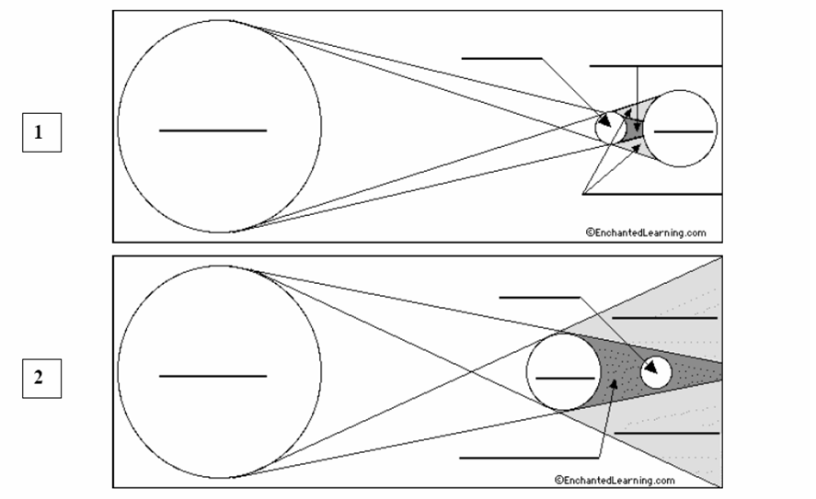
We will model the movements of Earth, the sun and the moon during eclipses.
Label the diagrams using the words: sun, moon, Earth, umbra, penumbra.
Identify 1 and 2 as a solar or lunar eclipse. Explain your answer.
Explain in full sentences if image 2 is a partial or total eclipse.
HINT
Students, remember….A total solar eclipse occurs when the moon moves in front of the sun. The Moon blocks the sun and creates a shadow on Earth. Umbra is the shadow on the Earth. S E M A total lunar eclipse occurs when the Earth moves between the moon and sun. The earth blocks the sun and creates a large shadow on the Moon. Umbra is the shadow on the moon. S M E A partial eclipse occurs when the moon or the Earth is in the partial penumbra.
Notes:
Please include tasks/questions here rather than just referring to a worksheet. This will save on photocopying and facilitate sharing with other schools.
Try and build tasks/questions which escalate through Bloom’s Taxonomy. This will help with differentiation.

Slide 22
We will model the movements of Earth, the sun and the moon during eclipses.
TRACK WITH ME
READ WITH ME
We will define solar eclipse.
We will define lunar eclipse.
We will compare partial and total eclipses.
DECLARE THE OBJECTIVE
Read the learning objective to your partner.
Notes:
Learning Objectives contain concepts (nouns, big ideas), skills (verbs, measurable behaviours) and sometimes context (restricting or targeting conditions).
●Example: Students will be able to describe the concept of density and apply it to floating and sinking.
●
Success criteria are specific measurable outcomes that if met mean that the student has met the learning objective.
Examples:
•Students will be able to compare densities of substances using mass and volume.
•Students will be able to identify whether a solid or liquid will float or sink in a liquid based on their densities.

